Slide 1
Tuition Award Process
George Washington University
Office of Graduate Student Assistantships and Fellowships
Rice Hall 302

Slide 2
Tuition Fellowship
Definition-A tuition award is the portion of the fellowship that is a direct credit to the student’s account for courses taken. It does not require service.
On sponsored research projects, GSAF will award a tuition fellowship for a GRA equal to 2/3 or 67% of a student’s tuition (up to 6 credits per semester fall and or spring) when:
The GRA is paid from a sponsored research project for at least a full semester
The student is fully funded (min $20k Doc/$16k Masters over 9 month period)
Full F & A is recovered from the sponsored research project
GSAF does not cover tuition for Milken Institute School of Public Health, School of Medicine and Health Sciences or the Law School
Tuition is allowed for formal cost share only if it is mandatory and approved on a case by case basis.

Slide 3
Tuition: How to Post an Award
In order to post a tuition award, a tuition detail code is required from Student Accounts. See next slide for details.
GA/GRA/Fellow-University funded
Based on the award letter, the school’s staff member or OGSAF staff member, if endowment funded or funded by GSAF, will enter the award in Banner.
Enter the tuition award in the Banner Student Accounts Module on the TZATUAW screen in the Banner Student Accounts Module.
GRA, GRF, GF Sponsored/Grant
Principal Investigator sends a copy of the signed Assistantship and Fellowship Recommendation Form along with a signed Acceptance Form to the School’s staff member assigned to enter Sponsored Projects’ tuition awards into Banner or to the Office of Graduate Student Assistantships and Fellowships (OGSAF), if tuition is OGSAF-funded.
Enter the tuition award in the Banner Student Accounts Module on the TZATUAW screen in the Banner Student Accounts Module.
OGSAF will enter all awards that it funds.

Slide 4
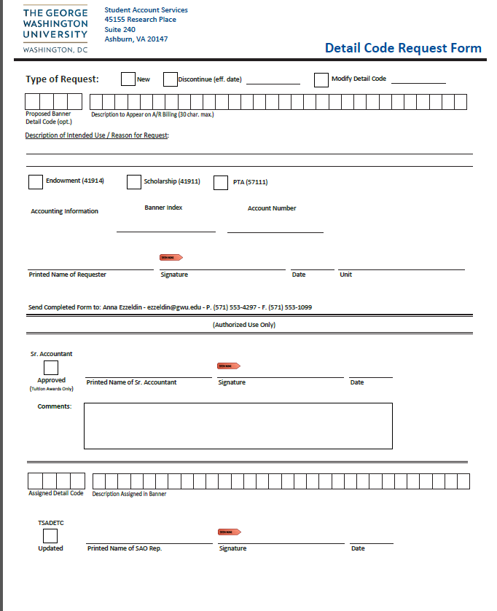
Tuition: Tuition Codes
Who sets up tuition codes? Student Accounts Office
How do you set up tuition codes? Complete the Detail Code Request Form and forward it to Anna Ezzeldin - ezzeldin@gwu.edu .

Slide 5
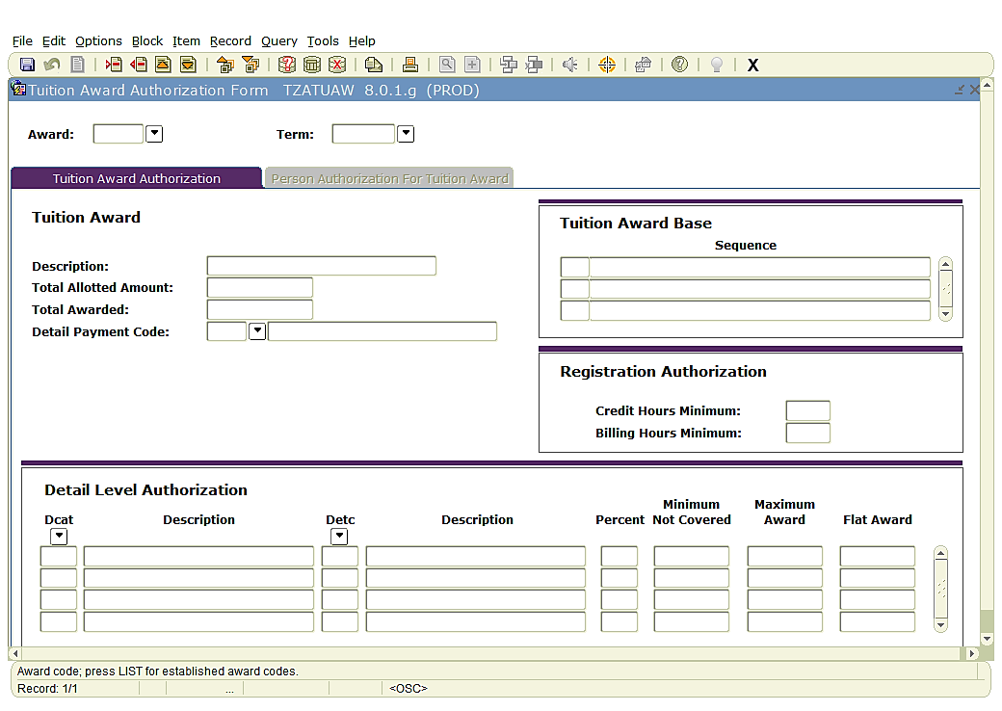
How to Post a Tuition Award
Enter semester;i.e.;201503
SA Code
Enter tuition code;ie.; T120

Slide 6
Cancellation Process-Tuition
To cancel out the tuition award in Banner:
Go to TSAACCT
Enter GWid, control +page down then go to Options tab and select Tuition Award Detail
Look for the award and term enter “D” in Delete Indicator, then save and exit.
OR
Go to TZATUAW

Slide 7
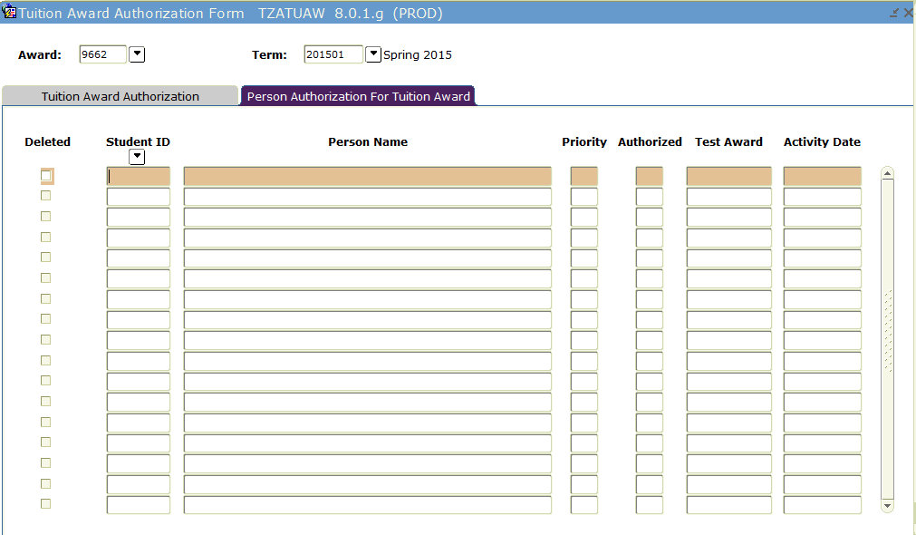
Cancellation Process-Tuition
Enter award code and term
Ctrl+ page down to get Person Authorization for Tuition Award.
Check the name/GWid to verify correct person identified
Check the box by the name under “Deleted”, save and exit.

Slide 8
Key Contacts:
For questions regarding tuition eligibility or cost sharing requests please contact Geri Rypkema at rypkema@gwu.edu
For questions regarding posting of tuition by GSAF contact Peter Van Riper at vanriper@gwu.edu
For access issue in Banner, please contact ithelp@gwu.edu

